Slide 1

Microeconomics I Topic 10: Monopoly II
Assistant Professor He Tai-Sen
ts.he@ntu.edu.sg

Slide 2
Outline
Assumptions of monopoly
Profit maximization
A Monopolistic market has no supply curve
Welfare analysis: the social cost of monopoly power
Pricing with market power
First-degree price discrimination
Second-degree price discrimination
Third-degree price discrimination

Slide 3
Pricing with market power
In Monopoly I, we assume that a monopolist can only charge the same price for all consumers. Suppose that you are the manager of the company, you may want to use the market power more effectively by charging different prices to different consumers or by charging different prices to the same consumer for different units the consumer buys. These practices are known as price discrimination.
Can you think of any real-world examples?
Notes:
4
Gym membership (registration fee+ monthly fee), Student discount, Airfare, Reimbursement, Coupon, Textbook, Durian, car dealer, …

Slide 4
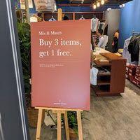
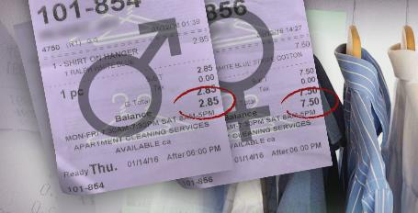
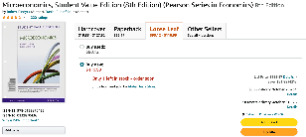

Pricing with market power
Notes:
4
Gym membership (registration fee+ monthly fee), Student discount, Airfare, Reimbursement, Coupon, Textbook, Durian, car dealer, …

Slide 5
Pricing with market power
Three types of price discrimination
First-degree price discrimination
Second-degree price discrimination
Third-degree price discrimination
Notes:
4

Slide 6
Pricing with market power ---First-degree price discrimination
Reservation price: maximum price that a consumer is willing and able to pay for a good.
First-degree price discrimination: practice of charging each consumer his/her reservation price.
P
MC
D
Q
Notes:
4

Slide 7
Pricing with market power ---First-degree price discrimination
Graphical analysis
No consumer surplus, No deadweight loss
P
P
C.S
MC
P.S
MC
P^{M}
DWL
P.S
MR
D
D
Q^{M}
Q
Q*
Q
Notes:
4

Slide 8
Pricing with market power ---First-degree price discrimination
It is typically very difficult to implement perfect first-degree price discrimination because consumers may be unwilling to reveal their true reservation prices.
How to implement first-degree price discrimination?
Negotiation and bargaining
How does a car salesperson practice price discrimination? How does the ability to discriminate correctly affect his or her earnings? By sizing up the customer, the salesperson determines the customer’s reservation price. Through a process of bargaining, a sales price is determined. If the salesperson has misjudged the reservation price of the customer, either the sale is lost because the customer’s reservation price is lower than the price offered by the salesperson or profit is lost because the customer’s reservation price is higher than the salesperson’s offer. Thus, the salesperson’s commission is positively correlated to his or her ability to determine the reservation price of each customer.
Notes:
4

Slide 9
Pricing with market power ---Second-degree price discrimination
In some markets, each consumer purchases many units of a good over any given period, his reservation price declines with the number of units purchased. A firm can discriminate according to the quantity consumed. This is called second-degree price discrimination (practice of charging different prices per unit for different quantities of the same good or service).
Example:
Buy one get one 20% off
Loyalty and reward cards for frequent customers
Notes:
4

Slide 10






Pricing with market power ---Second-degree price discrimination
Graphic analysis
P
$$P^{M}$$
P.S
$$P^{W}$$
P.S
P.S
$$P^{0}$$
MC
MR
D
$$Q^{M}$$
$$Q^{W}$$
$$Q^{0}$$
Q
Notes:
4

Slide 11
Pricing with market power ---Third-degree price discrimination
Third-degree price discrimination: practice of dividing consumers into two or more groups with separate demand curves and charging different prices to each group. Exchange between groups is either disallowed or very costly.
Examples: movies, textbooks, coupons/rebates, credit card annual fee waiver.
Notes:
4

Slide 12
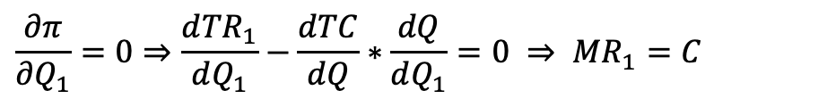
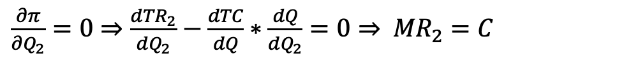
Pricing with market power ---Third-degree price discrimination
Profit maximization:
Max 𝞹(Q₁ ,Q₂)=TR₁(Q₁)+TR₂(Q₂)–TC(Q₁+Q₂)
Assume constant marginal cost: MC=C
Profit-maximizing condition:
=>Q₁* and Q₂*
$$\frac{∂π}{∂Q_{1}}=0⇒\frac{d{TR}_{1}}{dQ_{1}}−\frac{dTC}{dQ}∗\frac{dQ}{dQ_{1}}=0 ⇒ {MR}_{1}=C$$
$\frac{∂π}{∂Q_{2}}=0⇒\frac{d{TR}_{2}}{dQ_{2}}−\frac{dTC}{dQ}∗\frac{dQ}{dQ_{2}}=0⇒ {MR}_{2}=C$
Notes:
4

Slide 13




Pricing with market power ---Third-degree price discrimination
Graphic analysis:
P
$$P_{1}^{∗}$$
$$P_{2}^{∗}$$
MC=C
MR₁
MR₂
D₁
D₂
$$Q_{1}^{∗}$$
$$Q_{2}^{∗}$$
Q
Notes:
4

